Slide 1
Machine Learning Model Management
Presented by: Team 9
Akhilesh Tawde, Rohit Jain, Raj Phadke and Rishika

Slide 2
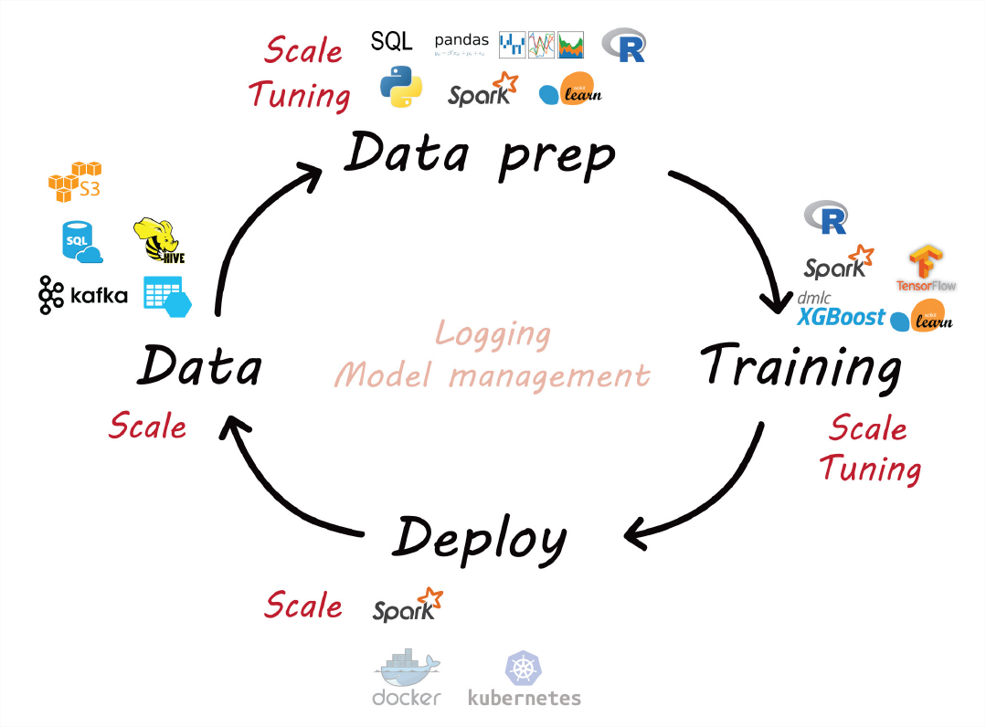
ML Lifecycle

Slide 3
Challenges in ML Model Management
Types of Model Management Challenges
1. Conceptual Challenges
- Involving questions such as what is a part of the model e.g. Model Validation
2. Data Management Challenges
- Relate to abstractions used in ML Pipelines e.g. Querying Model Metadata
3. Engineering Challenges
Building systems using different languages and specialized hardware
e.g. Multi Language Code Base

Slide 4
Model Management Methods
1. ProvDB: Provenance Enabled Lifecycle Management
2. ModelDB: Opportunities and Challenges
3. MLflow: Accelerating the ML Lifecycle
4. ML.NET: Model Serving from the edge to the Cloud

Slide 5
1. Provenance Enabled Lifecycle Management of Collaborative Data Analysis Workflows (ProvDB)
Provides unified management of all kinds of metadata about collaborative data science workflows that are generated during the analysis processes
The Goal of ProvDB
Develop tools and techniques for managing a large number of datasets and their versions over time
Manage derived data products
Support end-to-end data science lifecycle

Slide 6
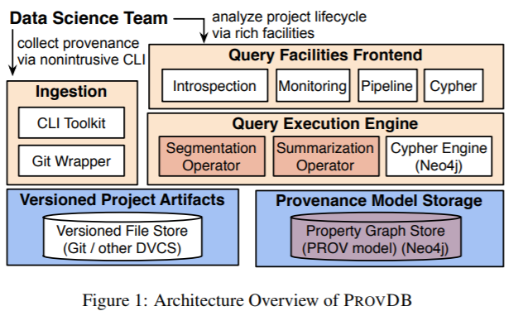
ProvDB Architecture
ProvDB adapts a schema later approach and is baselined on the W3C Prov Data Model
Ingestion Module captures provenance and metadata information
DVCS handles distributed and decentralized management of individual repositories
Neo4j uses graph database for provenance storage and allows to implement graph based querying
The Query Execution Engine supports segmentation and summarization queries

Slide 7
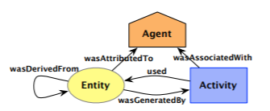
Provenance Graphs
Types of Vertices:
1. Entities(E) are the project artifacts (files, data, scripts) which the users work on
2. Activities(A) are the system or user interactions which act upon entities over a period of time (train, git commit etc.)
3. Agents(U) are the parties responsible for some activity (e.g. a team member, a system component)

Slide 8
Provenance Graphs (Continued)
Types of Edges:
1. Used(U): An activity started at time ‘t’ often uses some Entity ( U ⊆ A× E )
2. wasGeneratedBy(G): some entities were generated by the same activity at ‘t’ (G⊆ E× A)
3. wasAssociatedWith(S): an activity is associated with some agent during its exec (S⊆ A× U)
4. wasAttributeTo(A): some entity’s presence can be attribute to some agent (A⊆ E× U)
5. wasDerivedFrom(D): an entity was derived from another entity

Slide 9
ProvDB Creation Document Link
Link To Generate ProvDB Document in Python:
https://nbviewer.jupyter.org/github/trungdong/notebooks/blob/master/PROV%20Tutorial.ipynb
Other Useful Resources:
https://pypi.org/project/prov/
https://www.w3.org/TR/prov-dm/

Slide 10
Drawbacks and Solutions
ProvDB Challenges:
- To Capture the requisite provenance and context information
- Transparent Instrumentation Approaches where the information is captured with minimal involvement from the users are difficult to develop
Possible Solutions:
Using Shell Command Based Ingestion Frameworks: e.g. Apache Gobblin (https://github.com/foursquare/gobblin)
Caffe Deep Learning Framework Ingestor: (http://caffe.berkeleyvision.org/)

Slide 11
MODEL DB
MODELDB is the first open-source machine learning model management system and currently focuses on tracking models during the Experimentation phase. MODELDB automatically tracks models as they are built, records provenance information for each step in the pipeline used to generate the model, stores this data in a standard format, and makes it available for querying via an API and a visual interface.

Slide 12
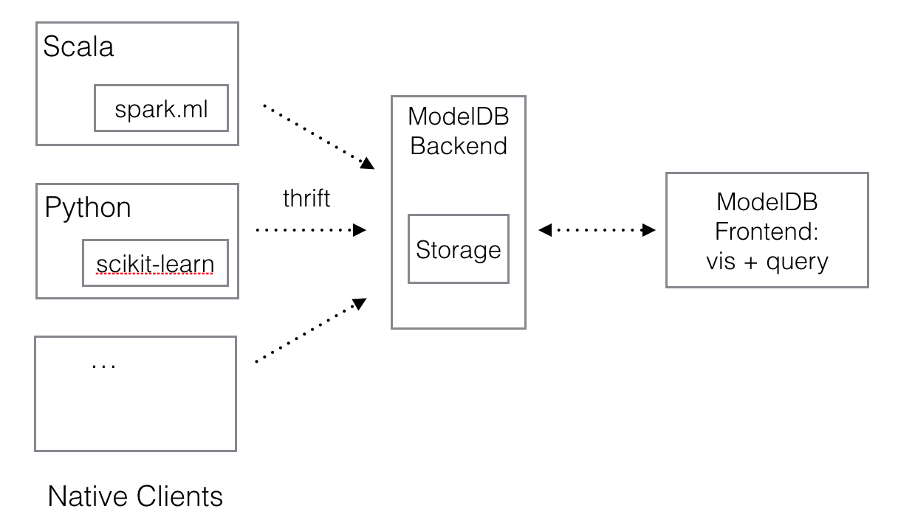
Architecture
ModelDB adopts a modular client-server architecture (below). Native clients for different languages (and ML packages) log data to the ModelDB server. All communication takes place through the ModelDB Thrift API. As a result, adding a native client for another language is straightforward. The web frontend surfaces data in the backend for query, visualization and updates.

Slide 13
How does it work?
ModelDB's Light API can be used with any ML environment to sync model
metrics and metadata or even entire config files by calling a few functions
Alternatively, ModelDB native clients for spark.ml and scikit-learn can be used to perform
automatic, fine-grained logging.
Unlike the Light API, native clients do not require the user to explicitly provide model data to
ModelDB.
The native clients can automatically extract relevant pieces of model data as the model is
being built and sync them with ModelDB.

Slide 14
Changes Need to made in normal programming
model.fit(data) --> model.fit_sync(data)
preprocessor.transform(data) --> preprocessor.transform_sync(data)
model.predict(data) --> model.predict_sync(data)

Slide 15
Demo
ModelDB can be integrated into different ML workflows http://modeldb.csail.mit.edu:8000/user/dxbxurZO0Uzv/notebooks/Iris-RandomForest.ipynb
ModelDB can visualize model data and results
http://modeldb.csail.mit.edu:3000/projects

Slide 16
What is ML.net ?
ML.NET is an open source ML framework allowing developers to author and deploy in their applications complex ML pipelines composed of data featurizers and state of the art ML models.

Slide 17
Model training concepts in ML.Net
Data represented as an IDataView interface.
In ML.NET, data is similar to a SQL view: It's a lazily evaluated, immutable, cursorable, heterogenous, schematized dataset.
An excellent document about the data interface is IDataView Design Principles.
Transformer represented as ITransformer interface.
A transformer is a component that takes data, does some work on it, and returns new transformed data.
For example, you can think of a machine learning model as a transformer that takes features and returns predictions.
Another example, text tokenizer takes a single text column and outputs a vector column with individual words extracted out of the texts.
Data reader represented as an IDataReader<T> interface.
The data reader is ML.NET component to create data. It takes an instance of T and returns data out of it.
For example, a TextLoader is an IDataReader<IMultiStreamSource>. It takes the source and produces data.
Estimator represented as an IEstimator<T> interface.
This is an object that learns from data. The result of the learning is a transformer.
You can think of a machine learning algorithm as an estimator that learns on data and produces a machine learning model.
Prediction function represented as a PredictionEngine<TSrc, TDst> class.
The prediction function can be seen as a machine that applies a transformer to one row, such as at prediction time.

Slide 18
Data
Data
In ML.NET, data is similar to a SQL view: It's a lazily evaluated, cursorable, heterogenous, schematized dataset.
It has Schema (an instance of an ISchema interface) that contains the information about the data view's columns.
Each column has a Name, a Type, and an arbitrary set of metadata associated with it.
The column's metadata contains information like slot names of a vector column and the like. The metadata itself is represented as another one-row data .
The data view is a source of cursors. Think SQL cursors: A cursor is an object that iterates through the data, one row at a time, and presents the available data.
Naturally, data can have as many active cursors over it as needed. Since data itself is immutable, cursors are truly independent.
Cursors typically access only a subset of columns: For efficiency, ML.NET computes only the values of columns that are needed by the cursor.

Slide 19
Transformer
Transformer
A transformer is a component that takes data, does some work on it, and returns new transformed data.
Most transformers in ML.NET tend to operate on one input column at a time, and produce the output column. For example, a new HashTransformer("bar", "foo") takes the values from column "foo", hashes them, and puts them into column "bar".
It's also common that the input and output column names are the same. In this case, the old column is replaced with the new one. For example, a new HashTransforme"foo") takes the values from column "foo", hashes them, and puts them back into "foo".
Any transformer, produces a new data view when Transform is called. Remember, data views are immutable.

Slide 20
Transformer chains
Transformer chains
A useful property of a transformer is that you can build a sequential application of transformers as yet another transformer:
C#
var fullTransformer = transformer1.Append(transformer2).Append(transformer3);
This property is commonly used in ML.NET: typically, the trained ML.NET model is a chain of transformers, which is, for all intents and purposes, a transformer.

Slide 21
Data reader and Estimator
The data reader is an ML.NET component to 'create' data: it takes an instance of T and returns data out of it.
The estimator is an object that learns from data. The result of the learning is a transformer.
In ML.NET, use this property to create learning pipelines that chain together different estimators:
rns data out of it.

Slide 22
Prediction function
The prediction function can be seen as a component that applies a transformer to one row.
Once you get the model (a transformer either trained via Fit(), or loaded from somewhere), you can use it to make predictions using the normal calls to modeltraransform(data). However, when you use this model in a real-life scenario, you often don't have many examples to predict on. Instead, you have one example at a time, and you need to make timely predictions on them immediately.
Of course, you can reduce this to the batch prediction:
Create a data view with exactly one row.
Call model.Transform(data) to get the predicted data view.
Get a cursor over the resulting data.
Advance the cursor one step to get to the first (and only) row.
Extract the predicted values out of it.

Slide 23
ML Flow

Slide 24
WHY ML FLOW?
Everyone here might till now have faced the situation of what parameters or metrics had fetched them the best outcome a few days back or a month back. Yes that’s the problem almost faced by all Data Scientist
Works with any library & language
Runs the same way anywhere
Helps to maintain parameters, metric and artifacts

Slide 25
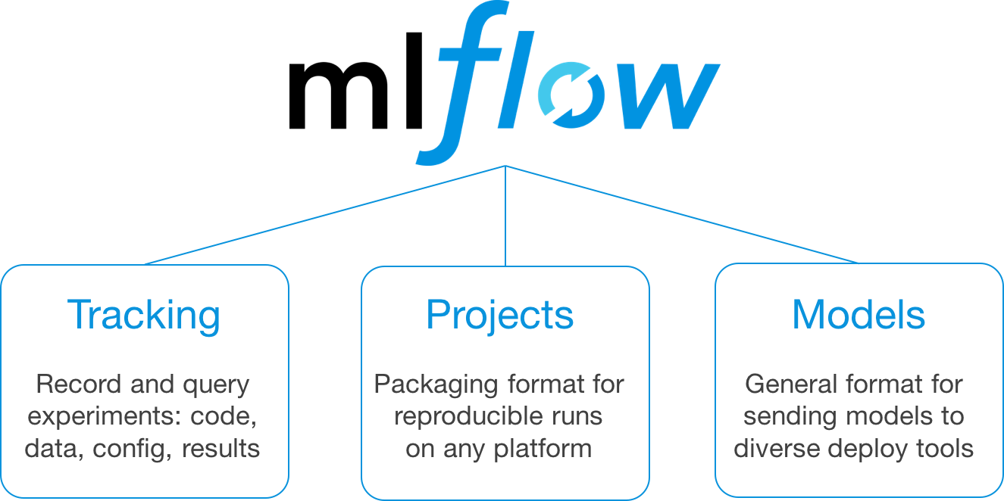

Slide 26
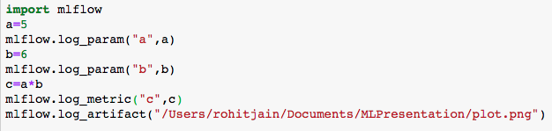
ML Flow Tracking : Basic Code
Logs Parameters
Logs Metric
Logs Artifacts

Slide 27
ML Flow Projects
Projects have diverse set of tools(Pytorch, Tensorflow), run on diverse set of environment(eg: Laptop, Docker)
ML Flow Project helps to manage and control code, config and data
ML Flow has API’s to run code locally or on cloud
Command to run :

Slide 28
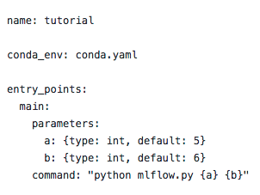
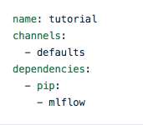
ML Project File & Running File

Slide 29

ML Flow Models
Helps to deploy model at various levels on cloud.
Deploying at Azure or Amazon Sagemaker

Slide 30
Reference Links
ML Flow : https://www.youtube.com/watch?v=ek4mJnDw8eE&t=214s
GIT Hub Link : https://github.com/jain-roh/MlFLowExample
ML.NET : https://en.wikipedia.org/wiki/ML.NET

